Slide 1
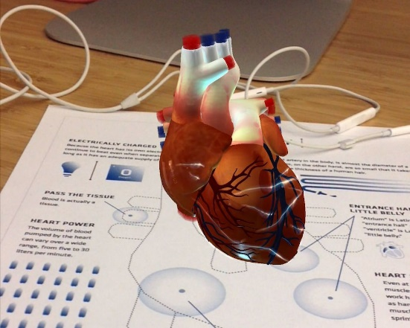
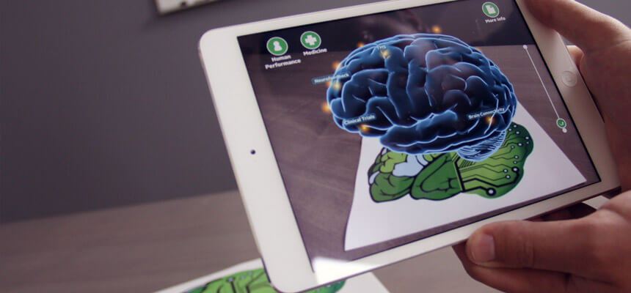

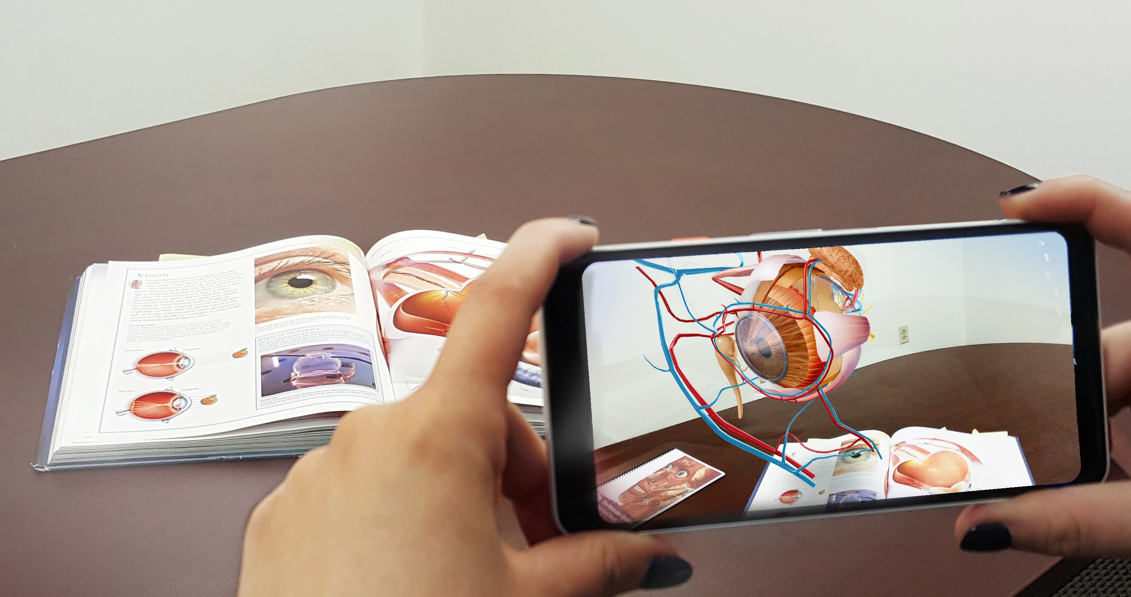
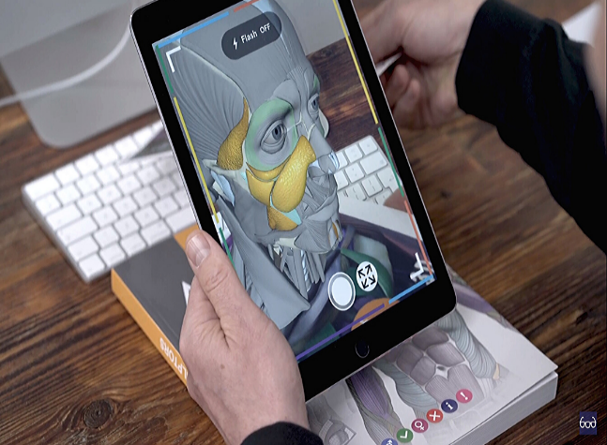
ORGment It
An app that allows the user to augment 3D organs onto 2D textbooks images to help students understand the unique human anatomy better !!!!

Slide 2

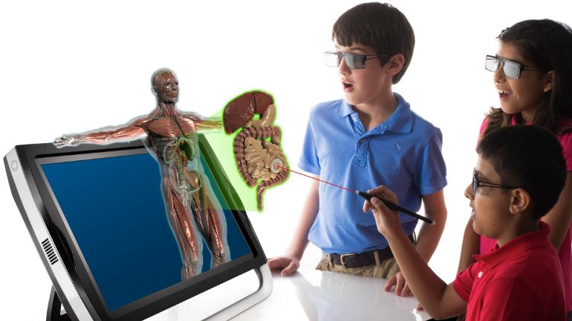
INTRODUCTION
For a decade now, 3D visualization has been working as a catalyst in many domains, especially architecture, manufacturing, product design and many more. As the industries are growing, so are their demands.
One such sector that requires our attention is the education sector. It is a common belief that seeing is believing and believing is knowledge. As technology has started growing rapidly over the past years, it has also decreased the affordability of such highly efficient resources.
Our mission, with the help of ORGment It, is to impart such visualisation and the concept of realism in the domain of biology, which is affordable and highly user efficient. Such a visualization when coupled with augmented reality makes this application highly powerful and user friendly.
Our application is built to increase the understanding of students about biomedical organs and enhance peer-to-peer knowledge by efficiently presenting it to the masses in a better format by making use of our detailed AR models.

Slide 3

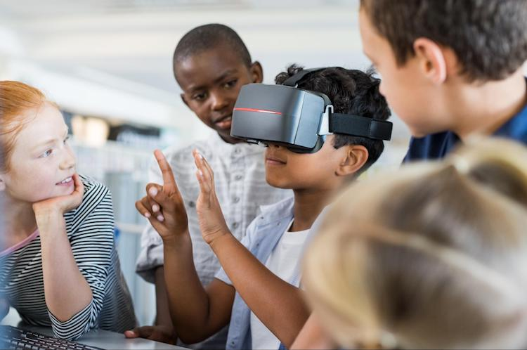
SIZE OF OPPORTUNITY
All schools/colleges within Karnataka
TAM :
This app finds its use to all high
school/college students across the globe
SOM :
All high school/college students who are a part of the Indian subcontinent.
TOM :

Slide 4
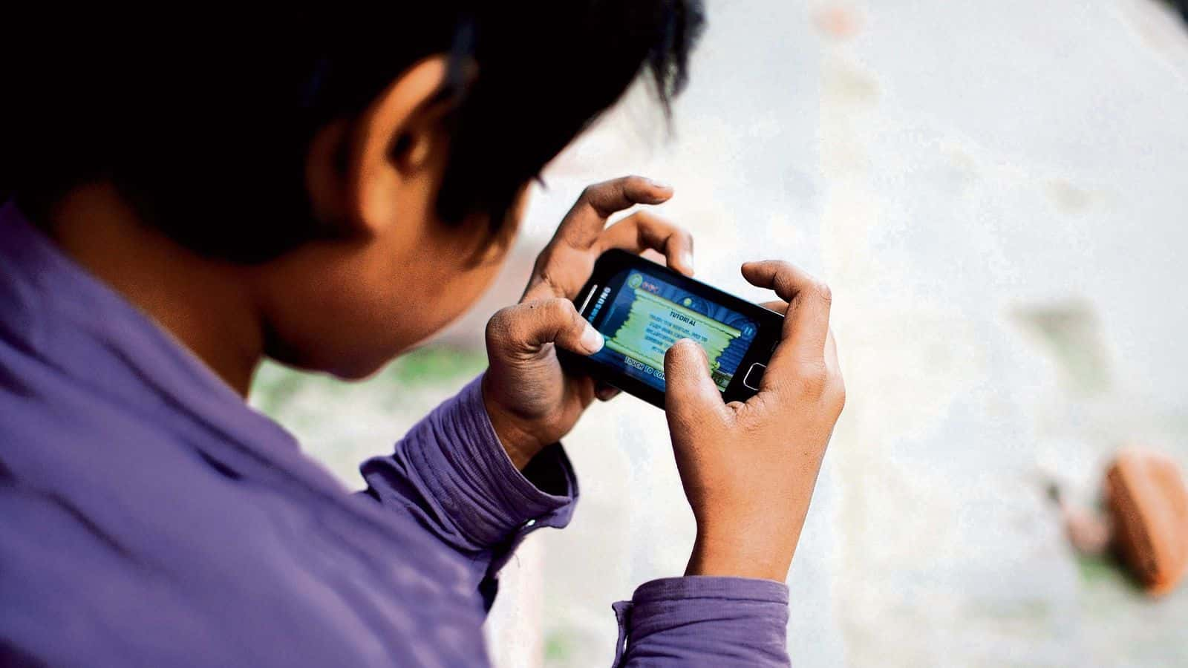
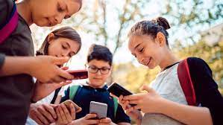
MARKET CHALLENGES
Providing mobile phones to students for personal educational purposes by parents.
Using this application in school hours during the classes.
Convincing people about the use of new technology such as Augmented Reality for better understanding.

Slide 5

SOLUTION PROVIDED
Scheduling the application according to the parents time to keep watch of there activity and giving parental control to the application.
Installing the application in school tabs and in teacher slides to explain using ORGment It to all students at once.
Convincing schools to make ORGment It app a part of their practical curriculum so that concepts can be conveyed uniquely and better.

Slide 6
COMPETITION AND USP
3D biology+: We stand better than this application with respect to model clarity and the user interface of the application.
AR anatomy 4D+: According to the reviews and usage of the application the application crashes at times and the service provided by them during any issues is null which would be better at ORGment It.
Humanoid 4D+: They showcase body parts with 2D images where each part can’t be explored in any other way than the given. Where as in ORGment It each part can be viewed in multiple ways (zoom in, zoom out, pivot).

Slide 7

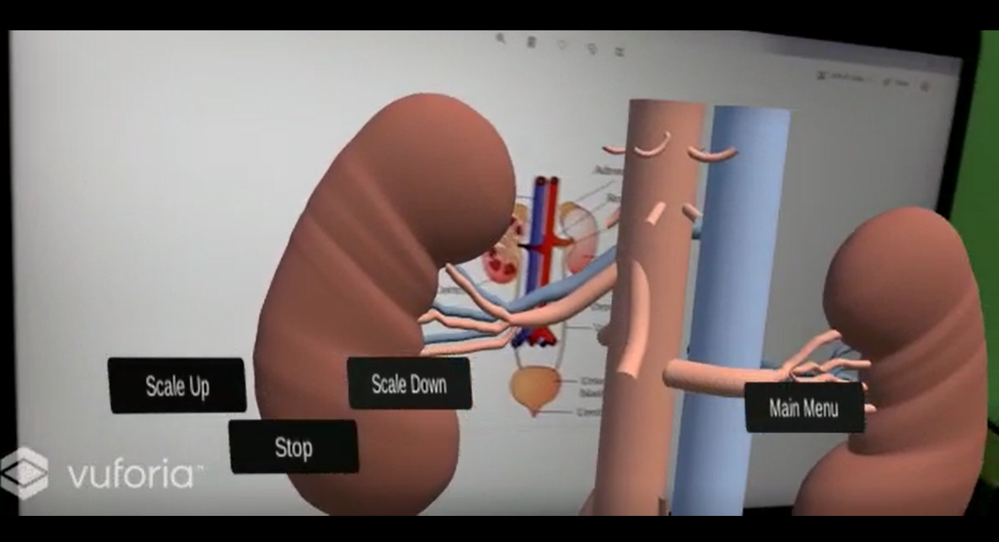
KEY MILESTONES
ORGment It completes its five months of rigorous work towards research, collecting data, completing the app, website, social media pages and a lot more.
By the completion of 12- Months since app launch, we would expect to have helped many students across the serviceable population.
We would also expect to have started implementing our unique procedure of encouraging peer-to-peer learning in the form of recorded video explanations of all alumni students post gaining knowledge from our application so that it can benefit a larger serviceable population.

Slide 8
MONEY NEEDED
While there wasn’t any heavy investment for the designing of this application as this is student-designed, we would still expect financial aid only in the development of the website, uploading of the application for public use and essentially for outreach.
The average cost for maintaining the domain website is about $50 (USD) per month.
The one time cost for uploading the app is $25(USD)
The marketing cost inclusive of beta testing, app market research, ASO tool, app marketing agency, app PR outreach, influencer marketing, average cost per install and cost per action sums up to a minimum of $6000-$7000(USD) per month.

Slide 9

FINANCIAL, METRICS
Metrics being tracked:
Daily Active users and Monthly active Users
Stickiness Ratio (DAU/MAU *100)
Average Session Length
Exit Rate (total visitors on screen/total exits from that screen)
Goal Completions (number of users to finish reviewing the quizzes)
Time to Goal Completion (time taken by users to complete the quizzes)
Financials being tracked:
Daily expenditure in the form of aforesaid conditions (financial aid)
Total number of installs
App cost payment by users for effective use post expiration of free trials

Slide 10
EXIT POSSIBILITIES
Can be sold to other multinational educational institutes such as BYJU’S, edtech and so on.
Change the investment to a new technology to reap even greater rewards.
Market it to schools or colleges giving them the ownership of the app.

Slide 11
TEAM
TEAM LEADER
ROSHAN N KALPAVRUKSHA
PRODUCT MANAGER
ROHAN N KALPAVRUKSHA
BACKEND DEVELOPMENT TEAM
JOSEPH ALWIN K.A
DHRUV SUVARNA
ANINDITA HK
DESIGN TEAM
VIKRAM S
JOCELYN GOMEZ
ANIRUDDH KRISHNAN
AMRUTHA ANUP
RESEARCH AND SUPPORT TEAM
ATISH K S
SHRINITHI NATARAJAN
MARKETING AND OUTREACH
SATHVIK M

Slide 12
PRODUCT

Slide 13
THANKYOU…..

